Slide 1
第六章
实战YOLOv3目标检测模型

Slide 2
目录
目标检测问题简介
系统分析深度目标检测网络
YOLO模型演进与发展
实战 YOLOv3 目标检测
实战更小更快的Tiny YOLOv3

Slide 3
目标检测问题简介

Slide 5
目标检测问题
图像分类
目标定位
目标检测
狗
狗

Slide 6
目标检测评估：Ground Truth
Bounding Box
Ground Truth

Slide 7
目标检测评估：Intersection over Union (IoU)
Bounding Box
Bounding Box
Ground Truth
Ground Truth
Intersection

Slide 8
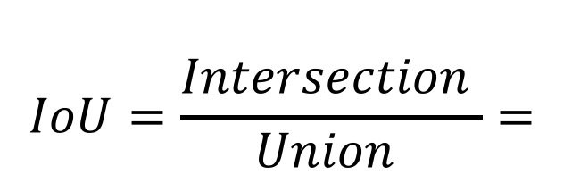
目标检测评估：Intersection over Union (IoU)
Bounding Box
Ground Truth
$$IoU=\frac{Intersection }{Union }=$$
Bounding Box
Ground Truth

Slide 9
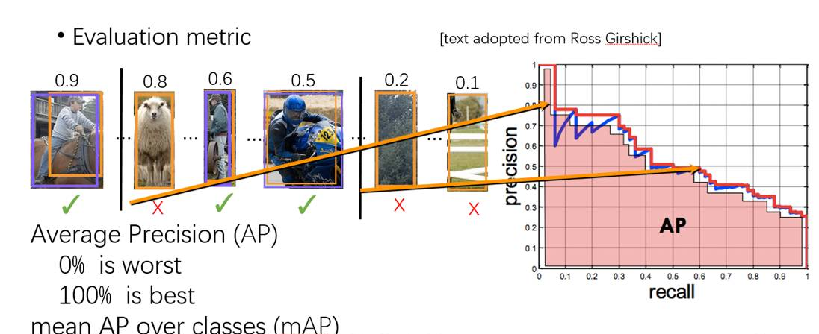
目标检测评估：mean Average Precision（mAP）

Slide 10
通用目标检测数据集
Pascal VOC
The PASCAL Visual Object Classes (VOC) Challenge
ILSVRC
The ImageNet Large Scale Visual Recognition Challenge
MS-COCO
Microsoft Common Objects in Context
OID
The Open Images Detection

Slide 11
系统分析深度目标检测网络

Slide 12
目标检测近20年发展

Slide 13
目标检测近20年里程碑

Slide 14
目标检测近10年提升

Slide 15
深度目标检测网络
两阶段检测器（Two-stage Detectors）
R-CNN
Fast R-CNN
Faster R-CNN
一阶段检测器（One-stage Detectors）
YOLO v1
YOLO v2
YOLO v3
R-FCN

Slide 16
R-CNN
开启CNN+目标检测的大门
Notes:
R-CNN 采用深度网络来对 object proposals 分类以进行目标检测，其缺点如下：
[1] - 训练是 multi-stage 的. a). R-CNN 首先采用 log loss 对 object proposals 微调 ConvNet； b). 然后将 ConvNet 特征送入 SVMs 分类器. 将 SVMs 作为目标检测器，取代微调的 softmax 分类器； c). 学习 bounding-box 回归器.
[2] - 训练的空间和时间代价较高. 训练 SVM 和 bounding-box 回归器时，需要对每张图像的每个 object proposal 进行特征提取，并写入磁盘. 采用深度网络，比如 VGG16，对 VOC07 trainval 数据集的 5K 张图片，这个过程需要 2.5 GPU-days；且提取的特征需要大量的存储空间.
[3] - 目标检测速度慢. 测试时，对每张测试图片的每个 object proposal 进行特征提取. 基于 VGG16 的检测，单张 GPU 卡，每张图片需要 47s.
Its drawbacks are obvious: the redundant feature computations on a large number of overlapped proposals (over 2000 boxes from one image) leads to an extremely slow detection speed (14s per image with GPU)，不是end-2-end，没对框进行回归调整。

Slide 17
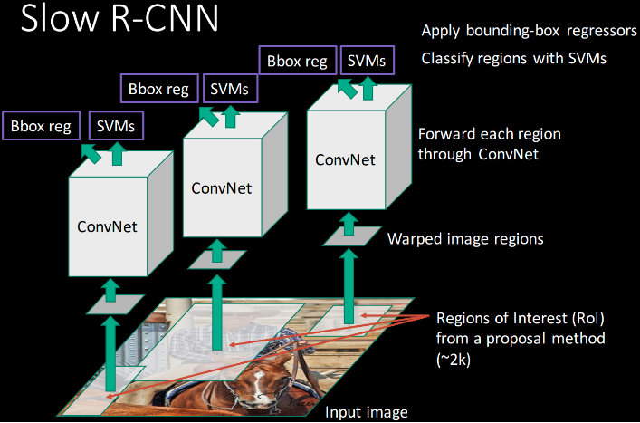
R-CNN
Notes:
R-CNN 采用深度网络来对 object proposals 分类以进行目标检测，其缺点如下：
[1] - 训练是 multi-stage 的. a). R-CNN 首先采用 log loss 对 object proposals 微调 ConvNet； b). 然后将 ConvNet 特征送入 SVMs 分类器. 将 SVMs 作为目标检测器，取代微调的 softmax 分类器； c). 学习 bounding-box 回归器.
[2] - 训练的空间和时间代价较高. 训练 SVM 和 bounding-box 回归器时，需要对每张图像的每个 object proposal 进行特征提取，并写入磁盘. 采用深度网络，比如 VGG16，对 VOC07 trainval 数据集的 5K 张图片，这个过程需要 2.5 GPU-days；且提取的特征需要大量的存储空间.
[3] - 目标检测速度慢. 测试时，对每张测试图片的每个 object proposal 进行特征提取. 基于 VGG16 的检测，单张 GPU 卡，每张图片需要 47s.
Its drawbacks are obvious: the redundant feature computations on a large number of overlapped proposals (over 2000 boxes from one image) leads to an extremely slow detection speed (14s per image with GPU)，不是end-2-end，没对框进行回归调整。

Slide 18
Fast R-CNN
Notes:
. 一张输入图片和多个 RoIs 作为全卷积网络的输入，每个 RoI 被池化到一个固定尺寸的特征图，并采用全连接层映射为一个特征向量. 对于每个 RoI，网络有两个输出向量：softmax 概率和 per-class bounding-box 回归偏移值. 网络是采用 multi-task loss 进行 end-to-end 训练的.
相对于 R-CNN 和 SPPNet， Fast R-CNN 解决了以上它们的不足，并提升了速度和精度. 其优势在于， [1] - 较高的检测质量(mAP) [2] - 训练是 single-stage 的，采用了 multi-task loss [3] - 训练可以对整个网络层进行更新 [4] - 不需要磁盘空间来缓存特征.

Slide 19
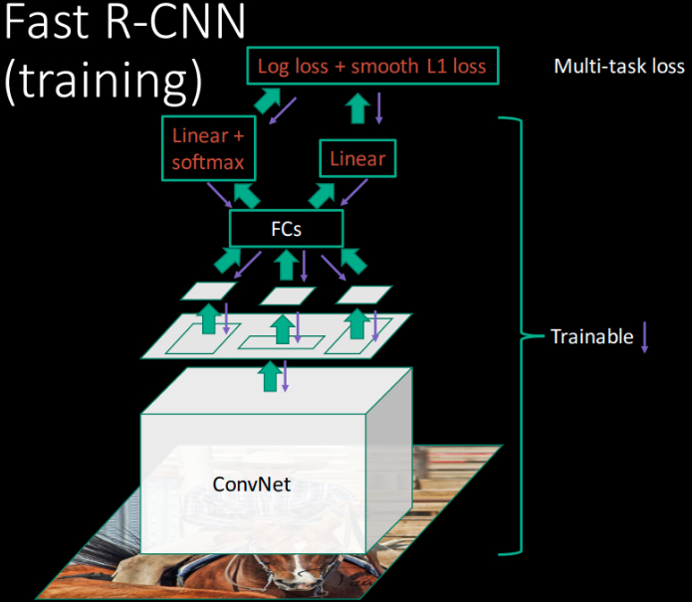
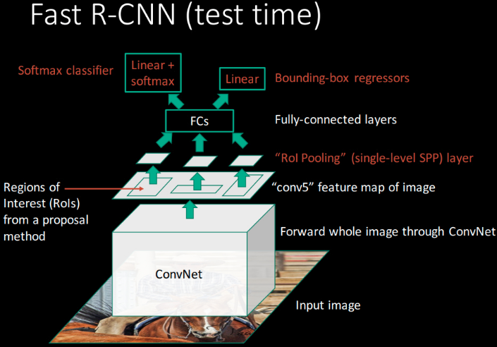
Fast R-CNN
Notes:
Fast R-CNN 采用整张图片和 object proposals 集作为网络输入.
网络首先几个卷积层和 max-pooling 层对整张图片处理，得到一个 conv feature map.
然后，对每一个 object proposal，采用 RoI pooling 层从 feature map 中提取一个固定长度的特征向量；
每个特征向量被送入一系列的全连接层，最终有两个分支：一个分支得到 softmax 概率值，共 K 个 object 类和一个 background 类；另一个分支针对 K 个 object 类输出四个实值，分别表示了每类 object 的 bounding-box 位置.

Slide 20
Faster R-CNN
Notes:
1. 提出了Region Proposal Network RPN，为全卷积网络(FCN) 替换selective search 来提取proposals
2. 首次将CNN的目标检测做到了end-2-end
3. 几乎做到了近实时 ~5fps
4. 提出了anchors
5. Faster RCNN网络支持输入图像的多尺度训练，由于RPN是FCN网络 和 RoI Pooling，使得faster rcnn对输入图像的尺寸无感

Slide 21
Faster R-CNN
Notes:
Although Faster RCNN breaks through the speed bottleneck of Fast RCNN, there is still computation redundancy at subsequent detection stage.

Slide 22
R-FCN
Notes:
1. 解决了“分类网络的位置不敏感性（translation-invariance in image classification）”与“检测网络的位置敏感性（translation-variance in object detection）”之间的矛盾，在提升精度的同时利用“位置敏感得分图（position-sensitive score maps）”提升了检测速度。
2. 解决Faster RCNN的计算冗余
3. 网络支持输入图像的多尺度训练

Slide 23
R-FCN
Notes:
1. 解决了“分类网络的位置不敏感性（translation-invariance in image classification）”与“检测网络的位置敏感性（translation-variance in object detection）”之间的矛盾，在提升精度的同时利用“位置敏感得分图（position-sensitive score maps）”提升了检测速度。
2. 解决Faster RCNN的计算冗余
3. 网络支持输入图像的多尺度训练

Slide 24
YOLO模型演进与发展

Slide 25
YOLOv3 与其他检测器对比
Notes:
YOLOv3 is extremely fast and accurate. In mAP measured at .5 IOU YOLOv3 is on par with Focal Loss but about 4x faster. Moreover, you can easily tradeoff between speed and accuracy simply by changing the size of the model, no retraining required!

Slide 26
COCO 数据集上的性能对比

Slide 27
YOLOv1：首个深度学习的一阶段检测器
Notes:
贡献：
1. the first one-stage detector in deep learning era
2. high detection speed
The YOLO Detection System. Processing images with YOLO is simple and straightforward. Our system (1) resizes the input image to 448 × 448, (2) runs a single convolutional net- work on the image, and (3) thresholds the resulting detections by the model’s confidence.

Slide 28
YOLOv1：首个深度学习的一阶段检测器
Notes:
The Model. Our system models detection as a re- gression problem. It divides the image into an even grid and si- multaneously predicts bounding boxes, confidence in those boxes, and class probabilities. These predictions are encoded as an S × S × (B ∗ 5 + C) tensor.

Slide 29
YOLOv1：首个深度学习的一阶段检测器
Notes:
Our detection network has 24 convolutional layers followed by 2 fully connected layers. Alternating 1 × 1 convolutional layers reduce the features space from preceding layers. We pretrain the convolutional layers on the ImageNet classification task at half the resolution (224 × 224 input image) and then double the resolution for detection.
1. YOLO 对相互靠的很近的物体，还有很小的群体检测效果不好，这是因为一个网格中只预测了两个框，并且只属于一类。
2. 同一类物体出现的新的不常见的长宽比和其他情况时，泛化能力偏弱。
3. 由于损失函数的问题，定位误差是影响检测效果的主要原因。尤其是大小物体的处理上，还有待加强。

Slide 30
YOLOv2：更快、更好、更强
Notes:
Most of the listed design decisions lead to significant increases in mAP. Two exceptions are switching to a fully convolutional network with anchor boxes and using the new network. Switching to the anchor box style approach increased recall without changing mAP while using the new network cut computation by 33%.
YOLOv2 performs on par with state-of-the-art detectors like Faster R-CNN with ResNet and SSD512 and is 2 − 10× faster.

Slide 31
YOLOv2：更快、更好、更强
Notes:
YOLOv2 performs on par with state-of-the-art detectors like Faster R-CNN with ResNet and SSD512 and is 2 − 10× faster.

Slide 32
YOLOv2：更快、更好、更强
Notes:
Most detection frameworks rely on VGG-16 as the base feature extractor [17]. VGG-16 is a powerful, accurate clas- sification network but it is needlessly complex. The con- volutional layers of VGG-16 require 30.69 billion floating point operations for a single pass over a single image at 224 × 224 resolution.
The YOLO framework uses a custom network based on the Googlenet architecture [19]. This network is faster than VGG-16, only using 8.52 billion operations for a forward pass. However, it’s accuracy is slightly worse than VGG- 16. For single-crop, top-5 accuracy at 224 × 224, YOLO’s custom model gets 88.0% ImageNet compared to 90.0% for VGG-16.
Darknet-19. We propose a new classification model to be used as the base of YOLOv2. Our model builds off of prior work on network design as well as common knowl- edge in the field. Similar to the VGG models we use mostly 3 × 3 filters and double the number of channels after ev- ery pooling step [17]. Following the work on Network in Network (NIN) we use global average pooling to make pre- dictions as well as 1 × 1 filters to compress the feature rep- resentation between 3 × 3 convolutions [9]. We use batch normalization to stabilize training, speed up convergence, and regularize the model [7].

Slide 33
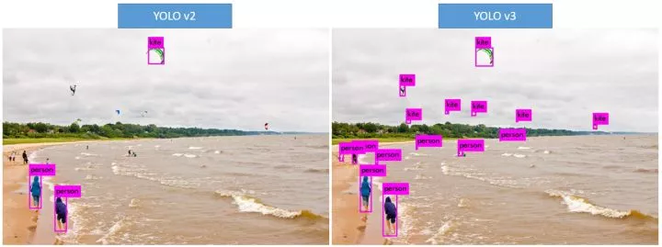
YOLOv3：小目标识别大提升
Notes:
自从 YOLO 诞生之日起，它就被贴上了两个标签：速度很快，不擅长检测小物体
由于原理上的限制，YOLO 仅检测最后一层卷积输出层，小物体像素少，经过层层卷积，在这一层上的信息几乎体现不出来，导致难以识别。
YOLOv3 在这部分提升明显，先看看小物体的识别。

Slide 34
YOLOv3：工业级高性能目标检测器
Notes:
https://www.jiqizhixin.com/articles/2018-05-14-4
https://pjreddie.com/darknet/yolo/

Slide 35
YOLOv3：Darknet-53 网络结构
Notes:
贡献：
1. 使用残差模型
2. 采用FPN
总结：
从YOLO的三代变革中可以看到，在目标检测领域比较好的策略包含：设置先验框，采用全卷积做预测，采用残差网络，采用多尺度特征图做预测。

Slide 36
实战 YOLOv3 目标检测

Slide 37
Darknet 高性能神经网络框架
Darknet
Darknet YOLO 实时目标检测框架

Slide 38
Darknet 使用预训练模型检测

Slide 39
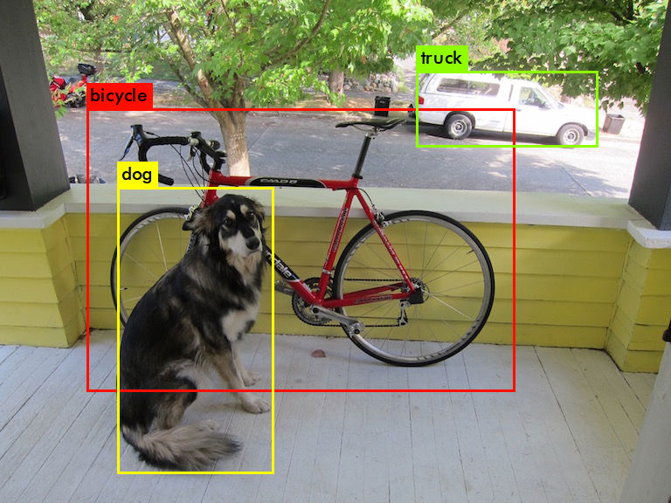
Darknet 使用预训练模型检测
Notes:
Darknet prints out the objects it detected, its confidence, and how long it took to find them. We didn't compile Darknet with OpenCV so it can't display the detections directly. Instead, it saves them in predictions.png. You can open it to see the detected objects. Since we are using Darknet on the CPU it takes around 6-12 seconds per image. If we use the GPU version it would be much faster.

Slide 40
Darknet 多张图像检测
Notes:
Darknet prints out the objects it detected, its confidence, and how long it took to find them. We didn't compile Darknet with OpenCV so it can't display the detections directly. Instead, it saves them in predictions.png. You can open it to see the detected objects. Since we are using Darknet on the CPU it takes around 6-12 seconds per image. If we use the GPU version it would be much faster.

Slide 41
YOLOv3 Keras 版本
https://github.com/qqwweee/keras-yolo3
模型转换：将 Darknet 训练的模型权重转换为 Keras h5 模型文件

Slide 42
Keras YOLOv3目标检测（图像）

Slide 43
Keras YOLOv3目标检测（图像）

Slide 44
Keras YOLOv3目标检测（视频）

Slide 45
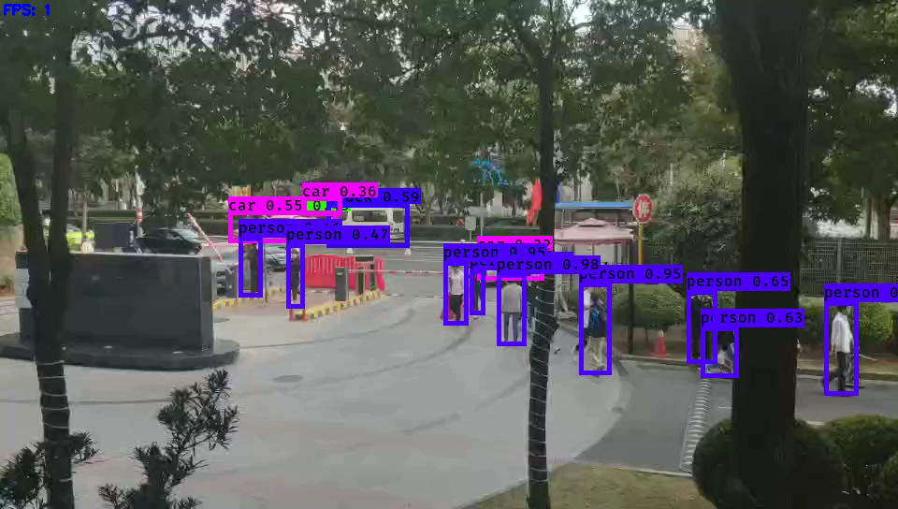
Keras YOLOv3目标检测（视频）

Slide 46
Try it
“Hello TensorFlow”

Slide 47
实战更小更快的Tiny YOLOv3

Slide 48
YOLOv3 问题
速度太慢

Slide 49
Tiny YOLOv3 Keras 版本

Slide 50
Keras Tiny YOLOv3目标检测（视频）

Slide 51
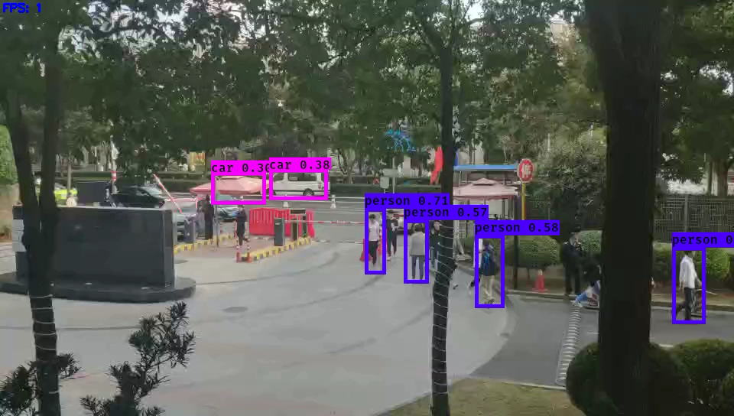
Keras Tiny YOLOv3目标检测（视频）
8x

Slide 52
Try it
“Hello TensorFlow”

